Slide 1
Wafer Fault Detection

Slide 2
Objective:
To build a classification methodology to predict the quality of wafer sensors based on the given training data. The model will detect non functional wafer and gives information of that wafer to user.
Benefits:
Detection of wafer which is soon going to be non functional.
Gives better insight of active and non active wafers.
Helps in easy flow for managing resources.
It will reduce Manual inspection for wafers .
User Friendly
Gives better insight of data
Help millions of businesses

Slide 3
Data Sharing Agreement :
Sample file name (example : Wafer_15010_130532)
Length of date stamp(8 digits)
Number of Columns(590)
Column names (Sensor-1 to Sensor-590)
Column data type(integer)

Slide 4
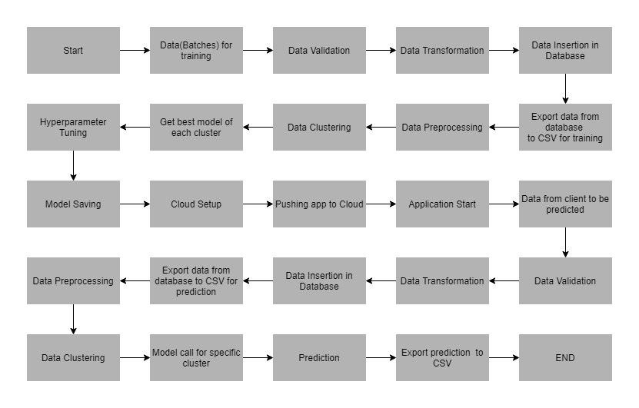
Architecture

Slide 5
Choose Data Source:
For the convenience of user we have giving multiple data sources from where user can upload his data on the web app. User can upload from clouds (AWS, Azure, GCP), Databases(Mongo, Cassandra, MySQL) and local machine.
Data Preprocessing:
Data preprocessing is the process of transforming raw data into an understandable format. It is also an important step in data mining as we cannot work with raw data. The quality of the data should be checked
before applying machine learning or data mining algorithms.
Data Preprocessing will be having the following sections:
Delete Columns
Handle Outliers
Handle Duplicate Data
Handle Missing Data
Handle Imbalanced Data

Slide 6
EDA:
Exploratory Data Analysis is a process of examining or understanding the data and extracting insights or main characteristics of the data. EDA is generally classified into two methods, i.e. graphical analysis and non-graphical analysis. EDA is very essential because it is a good practice to first understand the problem statement and the various relationships between the data features before getting your hands dirty.
EDA will be having the followings sections:
Data Summary
Show Dataset
Missing Values Report
Correlation Report
Outlier Report
Plots
Profiler Report

Slide 7
Feature Engineering:
Data Science is not a field where theoretical understanding helps you to start a career. It totally depends on the projects you do and the practice you have done that determines your probability of success. Feature engineering is a very important aspect of machine learning and data science and should never be ignored. The main goal of Feature engineering is to get the best results from the algorithms.
Feature Engineering will be having the following sections:
Handle Columns DataType
Encodings
Scaling
Train Test Split
Feature Selection
Dimension Reduction

Slide 8
Download Model’s Binary File:
Allowing the user downloading the binary file of his model will provide the user flexibility to use the binary model and predict on the test whenever where ever required else he can use our web app’s prediction for doing the prediction.
Prediction:
In this section of the web app, the user will have to upload his binary file which was made after the model training. Using this binary file prediction will be made on the test data.
Download Report:
The user can download a detailed report of all the tasks performed by him.
Schedule Training:
The scheduler can be used if the user doesn’t want to train the model instantly. The user can schedule the training time and the model will be automatically trained at that particular time. User will also receive a notification email.

Slide 9
Data Validation and Data Transformation :
Name Validation- We validate the name of the files based on the given name in the schema file. We have created a regex pattern as per the name given in the schema file to use for validation. After validating the pattern in the name, we check for the length of date in the file name as well as the length of time in the file name. If all the values are as per requirement, we move such files to "Good_Data_Folder" else we move such files to "Bad_Data_Folder."Number of Columns – Validation of number of columns present in the files, and if it doesn't match then the file is moved to "Bad_Data_Folder.“
Name of Columns - The name of the columns is validated and should be the same as given in the schema file. If not, then the file is moved to "Bad_Data_Folder".
Data type of columns - The data type of columns is given in the schema file. It is validated when we insert the files into Database. If the datatype is wrong, then the file is moved to "Bad_Data_Folder".
Null values in columns - If any of the columns in a file have all the values as NULL or missing, we discard such a file and move it to "Bad_Data_Folder".

Slide 10
Data Insertion in Database:
Database Creation and connection - Create a database with the given name passed. If the database is already created, open the connection to the database.
Table creation in the database - Table with name - "Good_Data", is created in the database for inserting the files in the "Good_Data_Folder" based on given column names and datatype in the schema file. If the table is already present, then the new table is not created and new files are inserted in the already present table as we want training to be done on new as well as old training files.
Insertion of files in the table - All the files in the "Good_Data_Folder" are inserted in the above-created table. If any file has invalid data type in any of the columns, the file is not loaded in the table and is moved to "Bad_Data_Folder".

Slide 11
Model Training:
Data Export from Db :
The data in a stored database is exported as a CSV file to be used for model training.
Data Preprocessing :
Check for null values in the columns. If present, impute the null values using the KNN imputer.
Check if any column has zero standard deviation, remove such columns as they don't give any information during model training..

Slide 12
Clustering :
KMeans algorithm is used to create clusters in the preprocessed data. The optimum number of clusters is selected by plotting the elbow plot, and for the dynamic selection of the number of clusters, we are using "KneeLocator" function. The idea behind clustering is to implement different algorithms
To train data in different clusters. The Kmeans model is trained over preprocessed data and the model is saved for further use in prediction.
Model Selection :
After clusters are created, we find the best model for each cluster. We are using two algorithms, "Random Forest" and "XGBoost". For each cluster, both the algorithms are passed with the best parameters derived from GridSearch. We calculate the AUC scores for both models and select the model with the best score. Similarly, the model is selected for each cluster. All the models for every cluster are saved for use in prediction.

Slide 13
Prediction:
Data Export from Db:
The data in the stored database is exported as a CSV file to be used for prediction.
Data Preprocessing :
a) Check for null values in the columns. If present, impute the null values using the KNN imputer.
b) Check if any column has zero standard deviation, remove such columns as we did in training.
Clustering :
KMeans model created during training is loaded, and clusters for the preprocessed prediction data is predicted.
Based on the cluster number, the respective model is loaded and is used to predict the data for that cluster.
Once the prediction is made for all the clusters, the predictions along with the Wafer names are saved in a CSV file at a given location and the location is returned to the client.

Slide 14
Q & A:
Q1) What’s the source of data?
The data for training is provided by the client in multiple batches and each batch contain multiple files
Q 2) What was the type of data?
The data was the combination of numerical values.
Q 3) After the File validation what you do with incompatible file or files which didn’t pass the validation?
Files like these are moved to the Achieve Folder and a list of these files has been
shared with the client and we removed the bad data folder.

Slide 15
Q 4) How logs are managed?
We are using different logs as per the steps that we follow in validation and
modeling like File validation log , Data Insertion ,Model Training log , prediction log
etc.
Q 5) What techniques were you using for data pre-processing?
Removing unwanted columns
Checking and changing Distribution of continuous values
Removing outliers
Cleaning data and imputing if null values using the KNN imputer.
Scaling the data

Slide 16
Q 6) How training was done or what models were used?
Before diving the data in training and validation set we performed clustering by using The Kmeans model is trained over preprocessed data
As per cluster the training and validation data were divided.
After clusters are created we are using two algorithms, "Random Forest" and "XGBoost". For each cluster, both the algorithms are passed with the best parameters derived from GridSearch.
We calculate the AUC scores for both models and select the model with the best score.
Q 7) How Prediction was done?
The testing files are shared by the client .We Perform the same life cycle till the data is clustered .Then on the basis of cluster number model is loaded and perform prediction. In the end we get the accumulated data of predictions.

Slide 17
Q 8) What are the different stages of deployment?
We deployed in a GitHub, AWS and GCP and we have given a GitHub repository pipeline where we have uploaded project code.
Once we deployed our code in cloud and we performed UAT using Postman.

